Slide 1
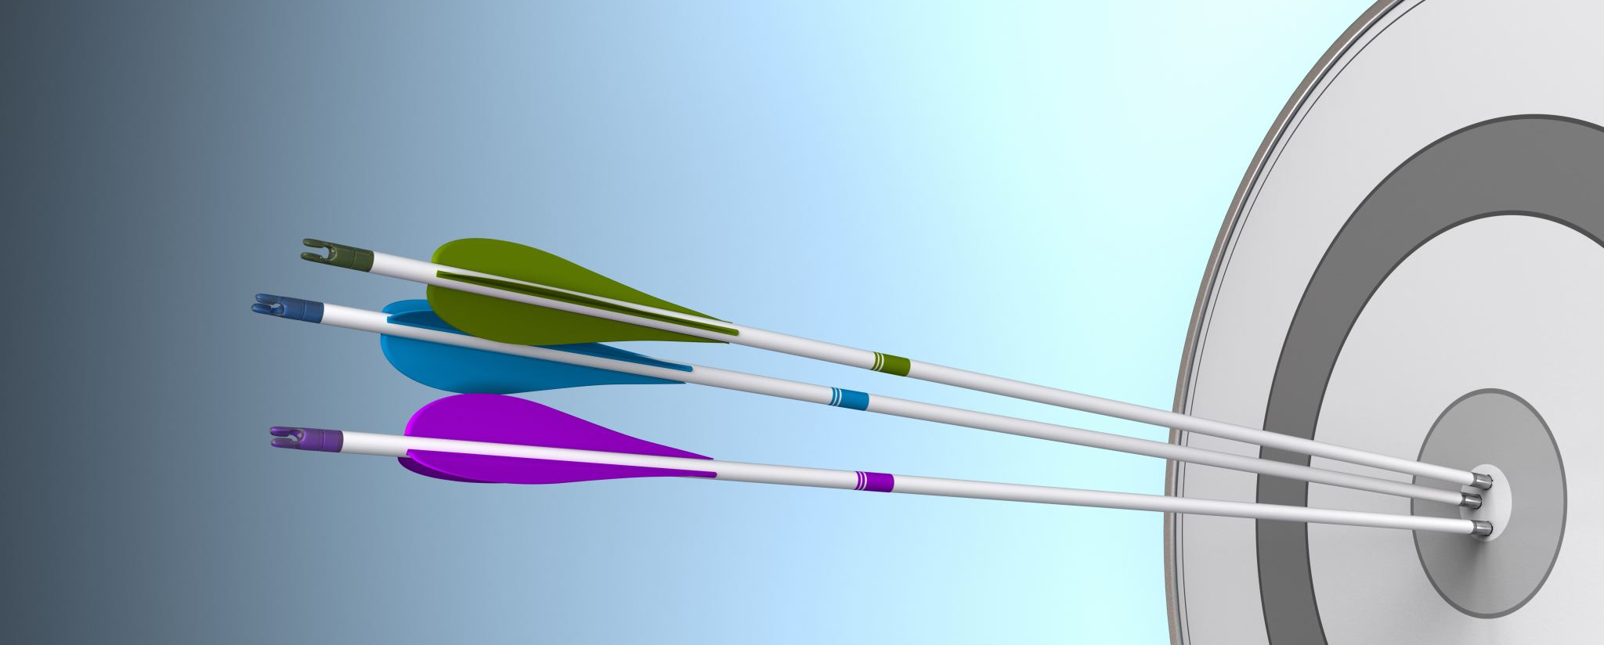
Feedback
Thunberg piece

Slide 2
FOCUS
Thesis needs the action principle; what does Thunberg want her audience to do (“to take action” is too vague!
Topic Sentences: Preview the device, reflect the overall goal/action principle/transition

Slide 3
EVIDENCE
Cite!
In your real paper, be sure to place citation at end of sentence
Be sure to work more with snippets→try taking a key piece of the evidence and embedding it in a sentence that paraphrases/ contextualizes (return to the sample MLK “venue” paragraph for a model

Slide 4
CONTENT/ ANALYSIS
Discuss the function of the device in that part of the speech
Be sure to link it to the overall purpose/goal/ action principle
As you relate to the thesis, “to take action” is too vague for significance

Slide 5
MISCELLANEOUS
Use speaker’s LAST name
Watch your own personal word jails
Avoid 1st and 2nd POV in analytical writing

